Slide 1
MPMC MINOR PROJECT
TRAFFIC LIGHT SYSTEM CONTROL USING 8051 MICRO CONTROLLER
Presented by:-Batch-08
LAKSHMI-181FA05093
RIYAN -181FA05161
ALISHAH -181FA05176

Slide 2
ABSTRACT:-
The main objective of this traffic light controller is to provide sophisticated control and coordination to confirm that traffic moves as smoothly and safely as possible. This project makes use of Traffic light trainer kit for indication purpose and a microcontroller is used for auto changing of signal at specified range of time interval. LED lights gets automatically turns on and off by making corresponding port pin of the microcontroller “HIGH”.

Slide 3
CONENTS:-
Introduction
Components
Circuit diagram
Working
Embedded c-code
Advantages
Disadvantages
Applications
Conclusion
References

Slide 4
INTRODUCTION:-
Traffic lights were first invented in the year 1868 at London’s House of Commons where traffic light signals were placed at intersections of George and Bridge Street. Later the traffic lights were developed in the year 1914 by an American Traffic Signal Company, which fixed green and red lights at corners of the 105th street and Euclid Avenue in Cleveland, Ohio. During this period traffic lights were controlled either by timing or by switching manually.

Slide 5
COMPONENTS:-
PC WITH KEIL U VISION 5
PROTEUS VERSION 8
8051 TRAINER KIT
TRAFFIC LIGHT TRAINER KIT
POWER SUPPLY

Slide 6

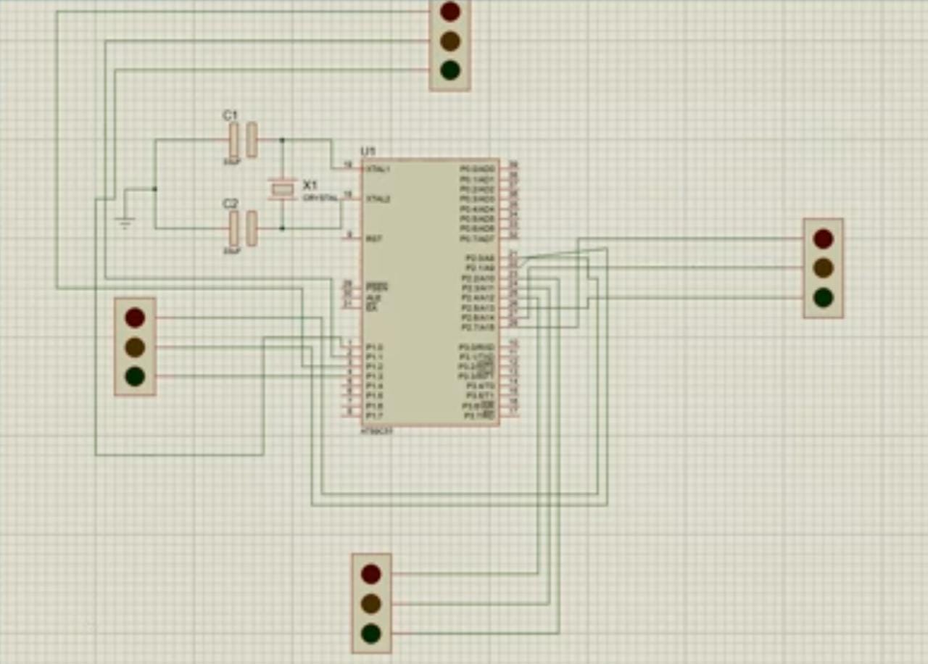
CIRCUIT DIAGRAM:-

Slide 7
WORKING:-
In the above circuit diagram of traffic light controller, An 8051 Microcontroller is the brain of this whole project and is used to initiate the traffic signal at the intersections on road.
This circuit diagram makes use of a crystal oscillator for generating frequency clock pulses.
The LEDs are interfaced in the form of the traffic lights to the Port one and port two of the microcontroller and are powered with 5v power supply.

Slide 8
The Traffic lights get automatically switched on and off by making the corresponding port pins of the microcontroller high, based on the 8051 microcontroller and its programming done by using KEIL software.
At a particular period of time, only the green light holds ON and the other lights remains OFF, and after sometime, the changeover traffic light control from green to red takes place by making the succeeding change for glowing of yellow LED.
This process continues as a cycle and gets repeated in all the four directions of north,east,west,south.

Slide 9
EMBEDDED C-CODE:-
#inlcude<stdio.h>
#include<reg51.h>
void delay()
{ int i
for(i=0;i<60000;i++);
}
int main()
{
P2=0x2A;
P1=0x04;
delay();

Slide 10
P2=0x85;
P1=0x04;
delay();
P2=0x90;
P1=0x0A;
delay();
P2=0x52;
P1=0x01;
delay();
return 0;
}

Slide 11
ADVANTAGES:-
Traffic signals help for movement of traffic securely without any collision.
They can reduce the number of accidents on roads like pedestrian accident and right-angle collision of two cars.
Signals can increase the capacity of traffic handling at the intersection.
The indications of the signals can be seen easily in foggy weather or at night time. Without signalling system, it is very difficult to control traffic by the traffic policeman at night or in foggy weather or on a rainy day.

Slide 12
DISADVANTAGES:-
Increasing traffic congestion, air pollution, and fuel consumption.
Increase in use of less-adequate roads to avoid traffic signs.
Excessive delay due to time allocated by the traffic signals.
During signals breakdown, there are serious and wide-spread traffic difficulties

Slide 13
APPLICATIONS:-
Road insertions
Cross roads
Pedestrian walk

Slide 14
REFERENCES:-
https://www.edgefx.in/how-traffic-light-control-system-works-elprocus/
https://civilnoteppt.com/advantages-and-disadvantages-of-traffic-signals/
https://www.pantechsolutions.net/blog/how-to-interface-traffic-light-with-8051-development-board/

Slide 15



Slide 16


